Slide 1

Blocking the Blocker – Studying the effects of Anti Ad-blocking
Rohit Gupta & Rohit Panda
Technische Universität München
Fakultät für Informatik
München, 26. Januar 2018
Notes:
Start gupta

Slide 2
Introduction
Online advertisements drives the economy of the World Wide Web.
Promotional content (ads) have found their way into websites at different strategic locations on webpages.
Users are employing Ad-blockers citing user experience, privacy and protection against malware as the top reasons.
Publishers are employing Anti Ad-blockers, scripts and notifications that ask users to disable Ad-blocker tools.

Slide 3
Roadmap
In our paper, we study various aspects of Anti Ad-blockers including:
We study the usage of Ad-blocker scripts and their mechanisms.
We discuss the methodology used in detecting Anti Ad-blockers.
We discuss on the findings of our results for the data set.
We analyse Anti Ad-blocker scripts.
We discuss the economic impact of Anti Ad-blockers.
We discuss the legality and ethical aspects of using Anti Ad-blockers.
We discuss alternatives to Anti Ad-blocking.

Slide 4
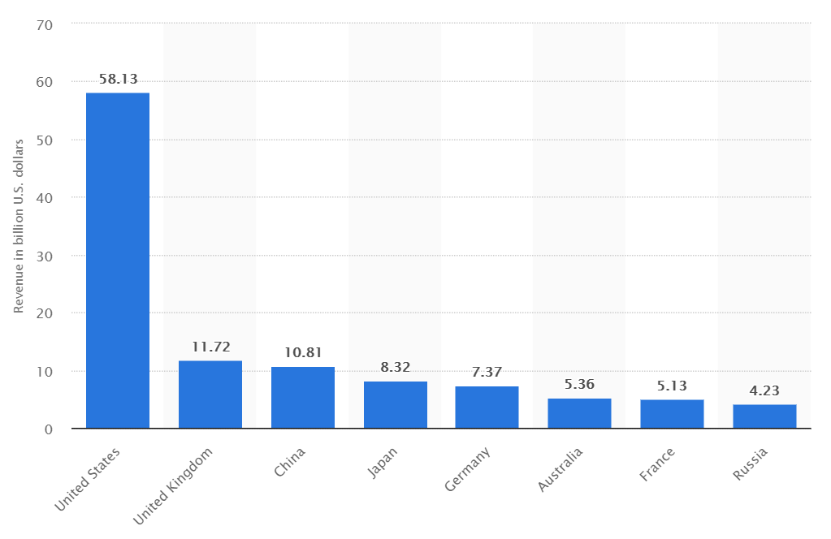
Revenue Generation for Ads
U.S. lead the market share with $58.13b revenue in 2017 followed by the U.K. with $11.72b and China with $10.81b.
Source: www.statista.com
Notes:
The major revenue categories ranked by percentage shares are as follows:
Search Advertising with $3.44B - 48%
Banner Advertising with $1.46B - 20.5%
Classifed Advertising with $0.95B - 13%
Social Media advertising with $0.89B - 12.5%
Video Advertising with $0.40B - 6%

Slide 5
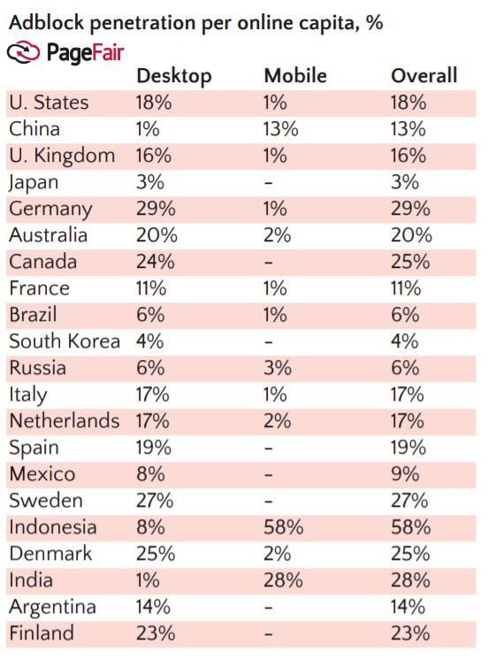
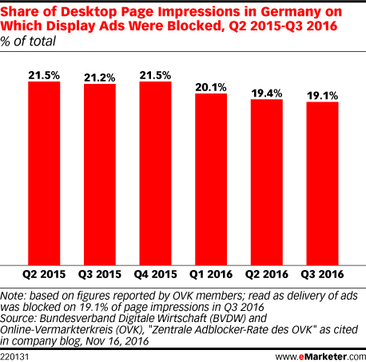
Ad-blocker popularity in Germany
PageFair Adblock penetration vs BVDW and OVK page impressions.
Source: PageFair and www.eMarketer.com
Notes:
The total number of devices that use Ad-block encompassed 615 million devices by 2016 end. Suburban and urban internet
users were 17% more likely to install Ad-blockers than those in rural areas. With the ever-increasing
number of Ad-block users the global cost of ad blocking surpassed the projected numbers of $40B in 2016

Slide 6
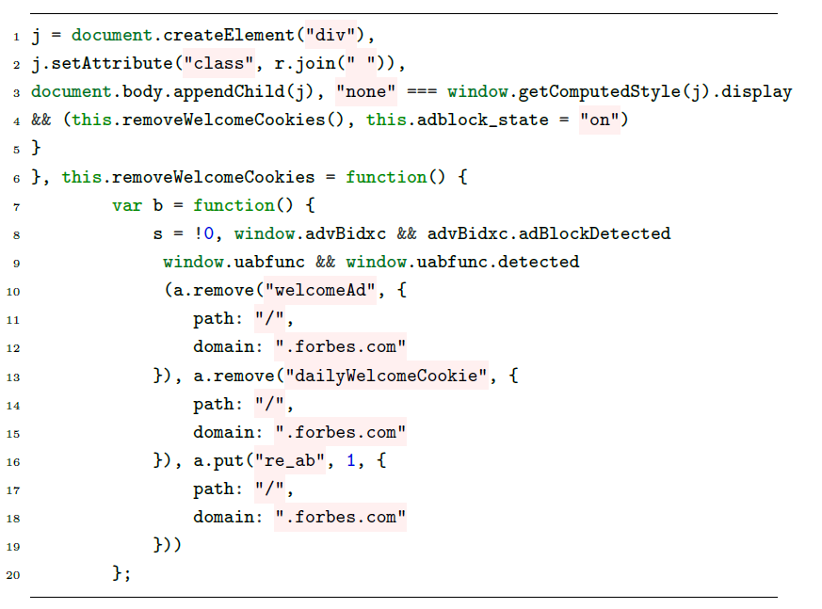
Ad-blocker scripts
Code showing how Forbes implements ads on their website:

Slide 7
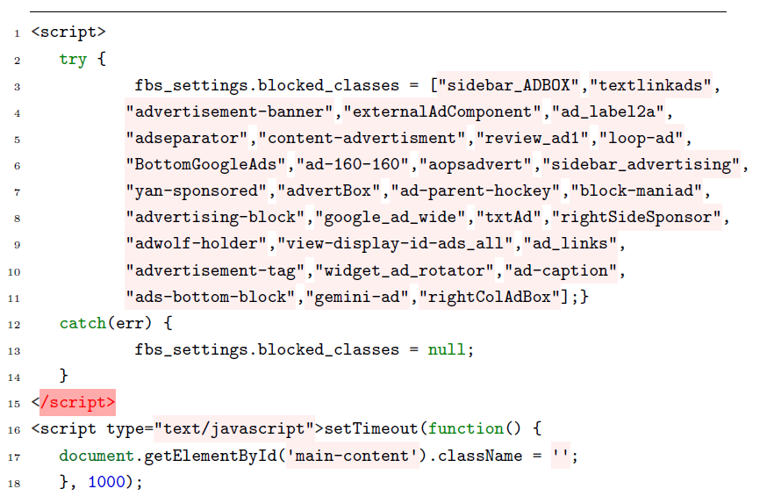
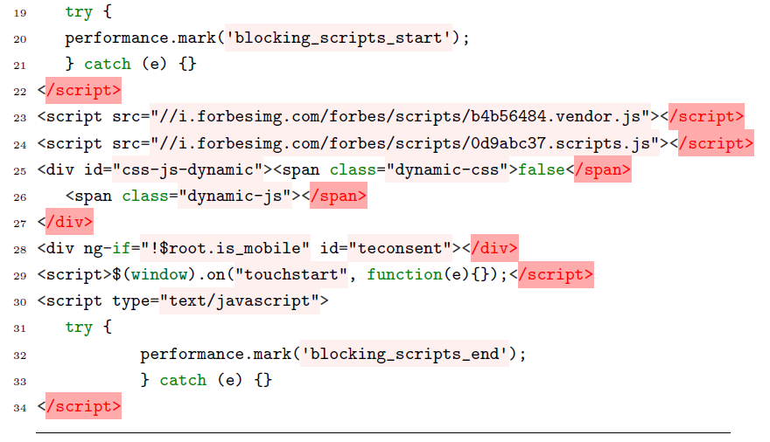
Ad-blocker scripts
Code showing how Forbes implements ad-blocker detection on their website:

Slide 8




Ad-blocker extensions
μBlock Origin for Chrome and Firefox
AdBlock for Chrome
Adblock Plus for Firefox, Chrome, Opera and Safari
AdBlock Pro for Chrome
Adguard for Chrome and Firefox
AdRemover for Chrome
Ghostery for Chrome, Firefox, Opera, Safari, Internet Explorer, Android and iPhone iOS
Simply Block Ads! for Chrome
SuperBlock AdBlocker for Chrome
μ Adblock for Firefox
uMatrix for Firefox, Chrome and Opera

Slide 9
Detecting Anti Ad-blockers
Anti Ad-blocker scripts change HTML content by:
adding extra HTML elements,
change in style of existing HTML elements,
changes in textual context.
These changes can be categorized into:
Node Changes: Extra DOM elements
Style Changes: Toggling of hidden div elements
Textual Changes: Changes in textual content
Structural Changes: URL redirections

Slide 10
Detecting Anti Ad-blockers: Methodology
We make use of Selenium Chrome Webdriver to launch two separate instances of Google Chrome.
Instance A is launched with Adblock Plus extension and instance B is without any extension.
Instances are compared w.r.t Node Features (div, h1, h2, h3, img, table, p, iframe and text nodes), Textual Features (#lines, #words, #text) and Structural Features (URL redirection).
These features are compared using a Python script and BeautifulSoup library is used for screen scraping.
These features are stored in a .csv file.

Slide 11
Detecting Anti Ad-blockers: Demo
Demo Video
Notes:
Start panda

Slide 12
Detecting Anti Ad-blockers: Model Training
We use three Machine Learning classifiers: J48 Decision Tree, Random Forest and Naive Bayes to identify websites that employ anti Ad-blockers.
We collected positive samples (websites that employ Anti Ad-blockers) and negative samples (website that do not employ Anti Ad-blockers) from sources such as anti-adblock-killer list and Alexa top-100 websites.
Information gain ratio is used for determining which features extracted are most important for learning and prediction.
Notes:
We then feed the extracted features to machine learning classifiers such as…
We use WEKA data mining toolkit for these classifiers.

Slide 13
Detecting Anti Ad-blockers: Classifier Evaluation
C4.5 Algorithm (J48 Decision Tree) uses a decision tree evaluation where each branch with the highest normalized information gain is chosen to make a decision.
Bayes Naive applies Bayes' theorem with strong (naive) independence assumptions between the features.
Random Forest Classifier is used for classification, regression and other tasks, that operate by constructing a multitude of decision trees at training time and outputting the class that is the mode of the classes (classification) or mean prediction (regression) of the individual trees.

Slide 14
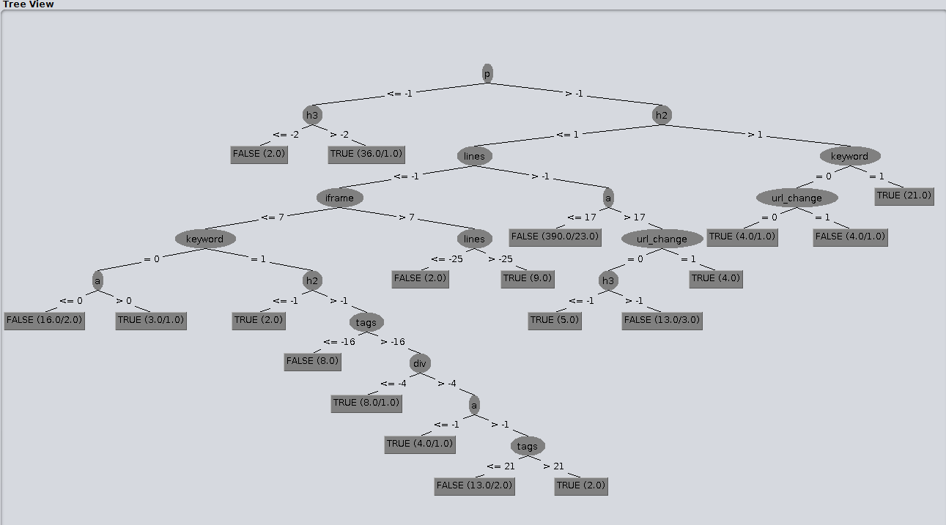
Detecting Anti Ad-blockers: Classifier Evaluation
Decision Tree visualization for Anti Ad-blockers:
Notes:
The splitting criterion is the normalized information gain (difference in entropy). The attribute with the highest
normalized information gain is chosen to make the decision.

Slide 15
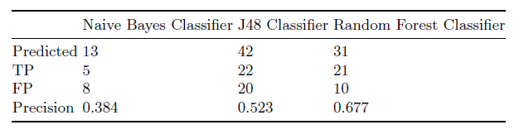
Datasets and Results
Our test set consisted of top ranked German websites from sources such as Alexa, Similarweb, Quantcast and TLD “de” sites.
Close to 25 out of 1477 (1.7%) top visited German websites employ Ad-block detection.
Certain websites still show advertisements or are allowed under Acceptable Ads programme.

Slide 16
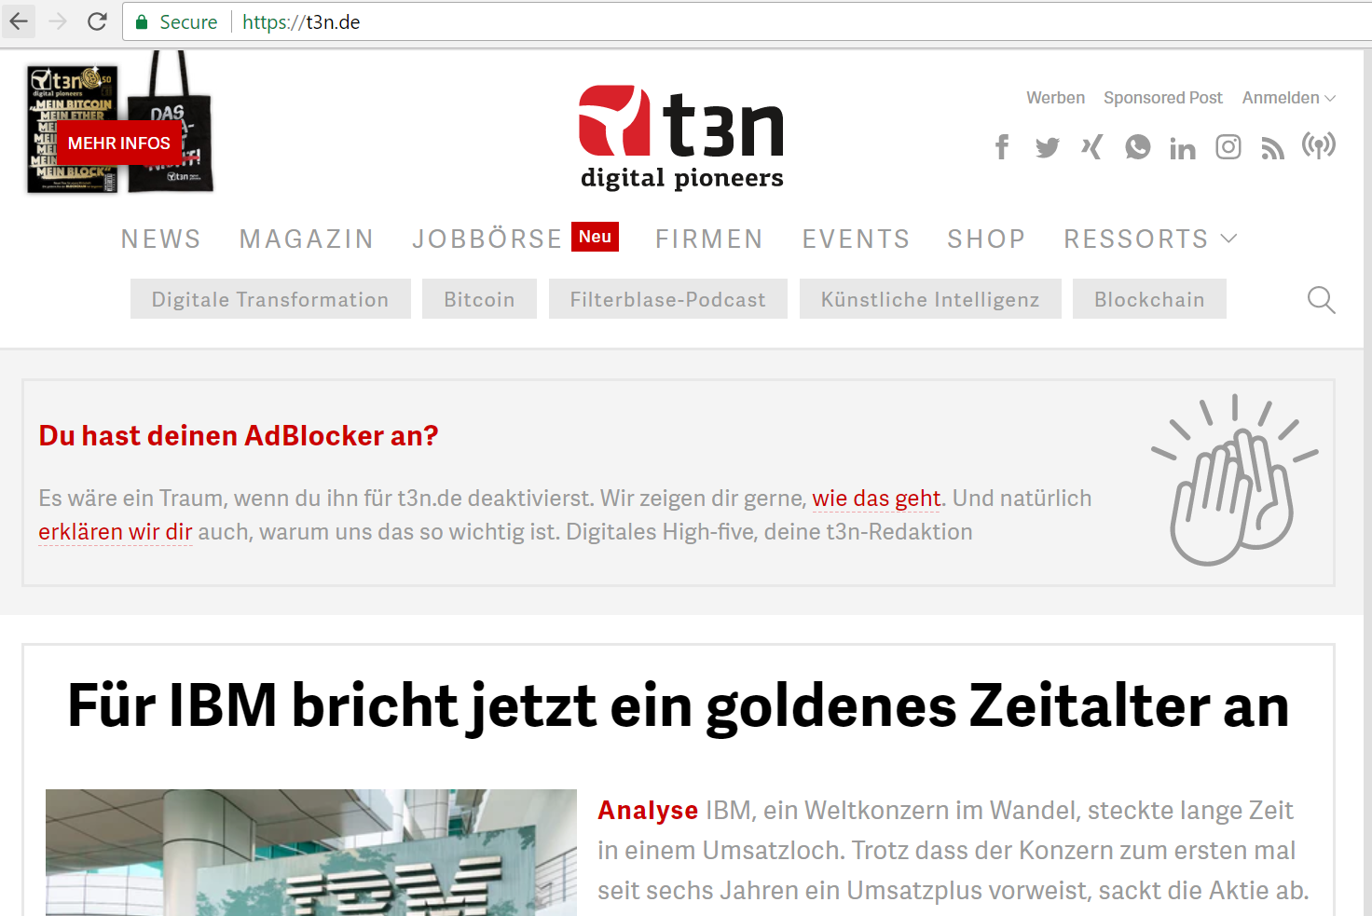
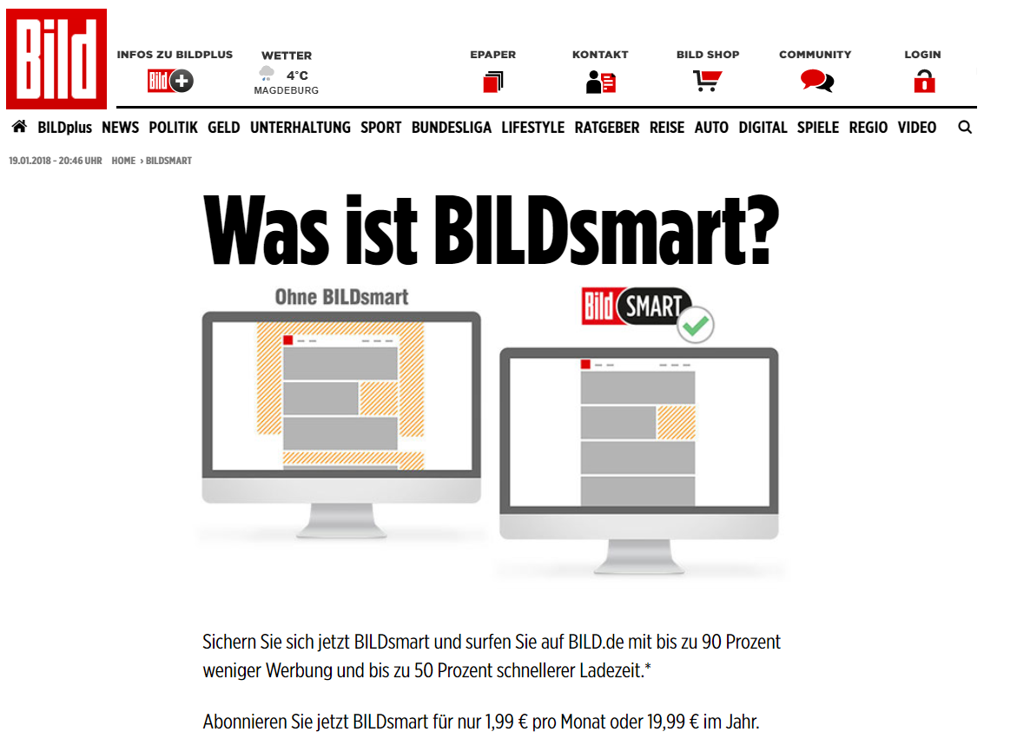
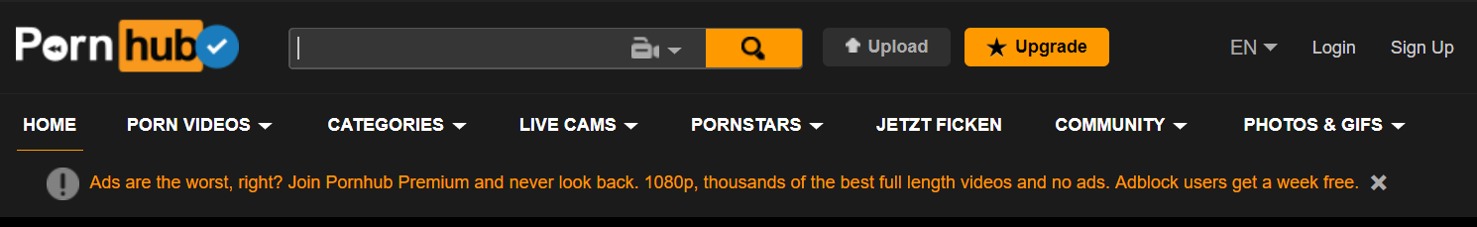
Ad-block Detection Responses: Types
Notes:
Start gupta

Slide 17
Datasets and Results: Geographical Comparison
Our reference research paper focussed on Alexa top-100K websites that includes majority of U.S.A. and China websites.
They found 686 websites in Alexa top-100K deploy Ad-blocker detection.
Only Google Germany and Amazon Germany fall under the Alexa top-100 websites.
In our analysis we found that 25 out of our 1477 test websites (top German websites) employ some kind of Ad-blocker detection.

Slide 18
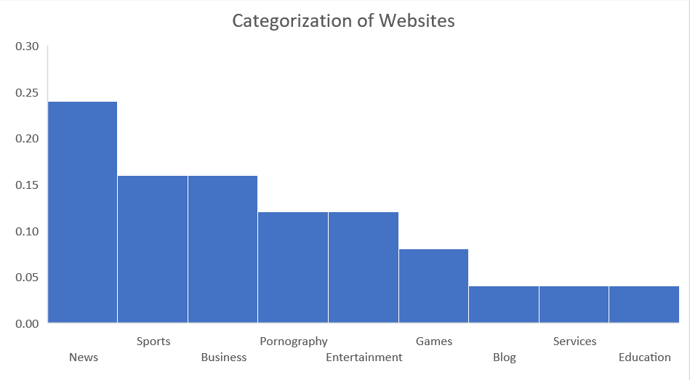
Datasets and Results: Categorization of Websites
Some of the top categories of websites deploying Ad-blocker detection:
Notes:
In Germany News Sports and Business were the top 3 categories while in the reference research paper Blogs News and Entertainment were the top categories.

Slide 19
Limitations
The lack of information, including a limit of websites that Alexa provides by country for free, forced us to induce a bias by selecting TLD with “de”.
Our methodology focusses only on homepage of such websites.
We remove any Anti Ad-block filters in EasyList for better detection. This may not be the default configuration used by users.
We consider only HTML and textual changes to websites.
Our focus is on Adblock Plus due to its popularity.
Notes:
Start panda: We do not consider cosine similarity and style features for the sake of simplicity.

Slide 20
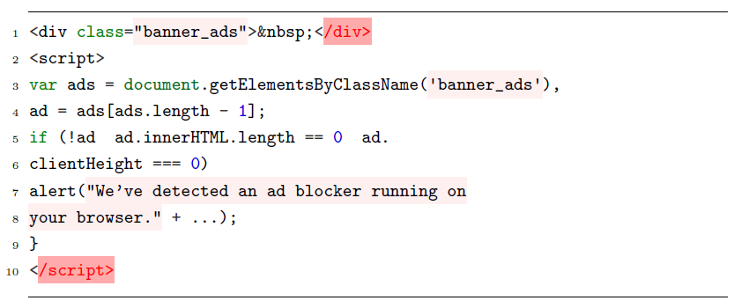
How Anti Ad-blocker scripts work
First party scripts either add a timing delay for displaying ads or add an empty <div> class as shown below. This acts as a bait.

Slide 21
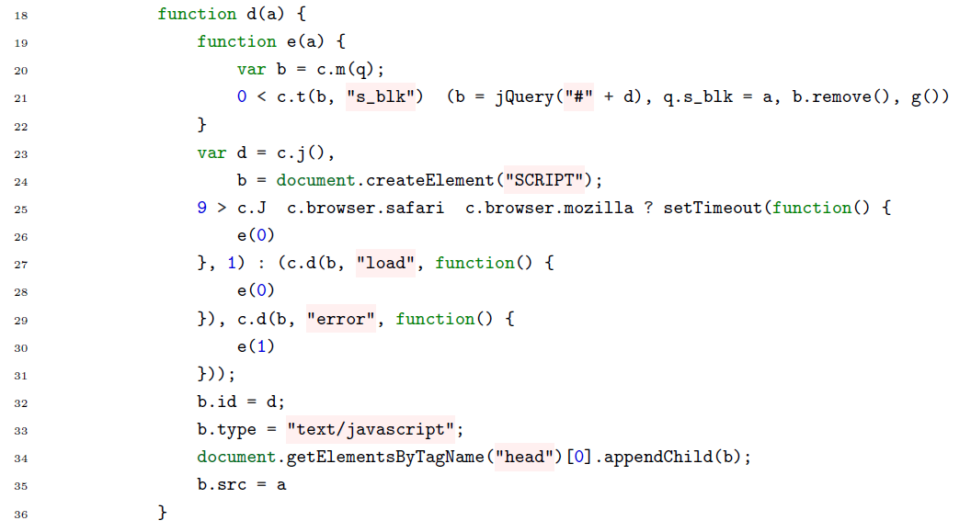
How Anti Ad-blocker scripts work
Third party script detects various browser extensions such as adblock, adblock_plus, adblock_pro.
Multiple baits and timeouts are used simultaneously.
Notes:
This is an obfuscated code, hiding actual implementation of ad-block detection. Downloads a script adsense.js, creates div elements and checks at random intervals.

Slide 22
Anti Ad-blocker alternatives: Acceptable Ads
Acceptable ads programme is provided by Adblock Plus for providing ads that do not disrupt or distort web content for users.
Placement
Distinction
Size
Unacceptable ads include animated ads, autoplay, expanding ads, pop-ups and pop-unders, rich media ads.
Notes:
Placement: Ads must not disrupt the user’s natural reading flow. They must be placed on the top, side or below the Primary Content.
Distinction: Ads should not be mixed with any other content so that it overlaps with the Primary Content.
Size: A strict individual size requirement is placed for Acceptable Ads.
Google Adsense

Slide 23
Anti Ad-blocker alternatives: Whitelists
This is analogous to anti-viruses that allow certain softwares to run on the system.
Adblock Plus charges high generating revenue sources for adding their websites to their whitelists while they do not charge for others.
Some websites have started charging users for an ad-free version of their websites by asking users to subscribing to them.

Slide 24
YES! Anti Ad-blocker killers also exists!
Anti Ad-block killers tricks sites that use Anti Ad-blocker detection into thinking the user is not using an Ad-blocker.
Anti Ad-block killers such as AAK are composed of a user script AakScript written in JavaScript and a filter list AakList that use the same syntax as filter lists of AdBlock and AdBlock Plus.
Ad-blockers still continue to run as normal using script managers like Greasemonkey or Tampermonkey.
Notes:
Start Gupta:

Slide 25
Anti Ad-blockers: Ethical aspect
Ads are the biggest sources of revenue for publishers on the world wide web.
Many websites have come up with a subscription model.
Some publishers, part of the Acceptable Ads programme, may not reveal all details regarding their deal with Ad-blocker companies.
Notes:
Pay journalists for their work on reporting.
While users should pay for viewing original content, ads should not be so intrusive.
On the other hand, if users choose to block ads, websites should not force them to disable ad-blockers.
- Charges a small fee to display content with less advertisements.

Slide 26
Anti Ad-blockers: Legality in Germany
There have been many legal battle fought till date, e.g., between Adblock Plus company Eyeo and Sueddeutsche Zeitung, Pro-Sieben-Sat.1, and IP Deutschland. However, German courts have always ruled in favour of Ad-blockers.
The Munich higher regional court noted that the Adblock Plus did not violate any competition laws in Germany, with Eyeo's business model not qualifying as “forbidden aggressive advertising”.
It is legal!
Notes:
After all who knows, maybe the judges also use ad-blockers.

Slide 27
Conclusion
25 websites out of 1477 websites use Ad-block detection scripts.
Random Forest classifier generates the highest precision.
Major categories of websites in Germany that use ad-blocker detection are News, Sports, Business and Pornography.
German courts have ruled in favour of Ad-blocker tools till date.
Notes:
While websites ads to generate revenues, users consider them to be annoying or potentially dangerous to their
system. However, such websites, question the integrity of such an unsaid agreement between
users and publishers by asking users to disable Ad-blockers. As such, the cat and mouse continues…

Slide 28
References
Haris et. al. Detecting Anti Ad-blockers in the wild. Proceedings on privacy enhancing technologies (2015)
Rishab et. al. Ad-blocking and counter blocking: A slice of the arms race (2016)
The cost of ad blocking: PageFair and Adobe report (2015)
Urteil des Landgerichts Hamburg (Az. 315 O 293/15) (2016) http://www.landesrecht-hamburg.de/jportal/portal/page/bsharprod.psml?showdoccase=1&doc.id=JURE170021729&st=ent

Slide 29
Thank you!

